Slide 1

Tennis

Slide 2
Techniques
Forehand: Left or right (the hand you write with)
Backhand: One-handed or two-handed
Lob: High & deep ball hit into the opponent’s side of the court
Volley: Shot hit from net/service line before hitting ground
Serve
Ace: Serve that receiver cannot touch
Double Fault: Miss two tries in serving the ball in the diagonal opposite serving box
Singles: Opponents switch sides
Doubles: One person takes position at the net, the other at the baseline

Slide 3
Grand Slams
Four major tennis tournaments in four different countries in a Calendar Year on three different surfaces
Australian Open: Melbourne, Australia (Hard)
French Open: Paris, France (Clay)
Wimbledon: London, UK (Grass)
US Open: Flushing Meadows, NY (Hard)
Champion accumulates 2,000 points on their ranking in Grand Slam events

Slide 4
Australian Open Series
Multiple tune-up tennis tournaments that lead up to the Australian Open
ATP Cup
Multi-city tournament for the men's players of 24 of the highest-ranked countries
Group Stages & Finals
Perth Arena, Queensland Tennis Center, Brisbane & Sydney Olympic Park Tennis Center
The countries are divided into six groups of four
Six group winners and two highest-ranked second place teams progress to the knockout finals stage

Slide 5
Australian Open Series (cont.)
Brisbane International
Queensland Tennis Center
WTA Premier tournaments of WTA tour
Adelaide International
Memorial Drive Park, Adelaide
Forms part of the WTA and ATP tours
Hobart International
Hobart International Tennis Center
Women's professional tennis tournament
Run-up to the Australian Open

Slide 6
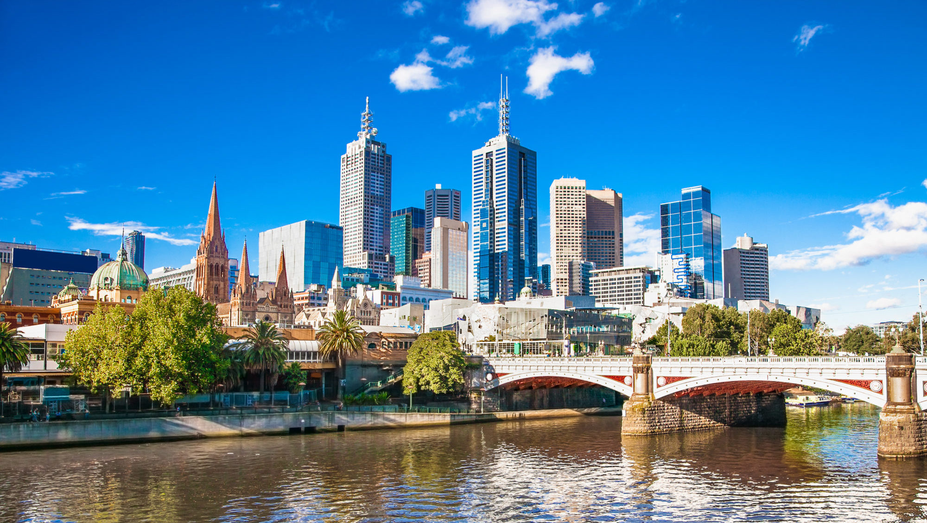
Australian Open
First Grand Slam of the Calendar Year
Played at Melbourne Park since 1988
Three main courts
Rod Laver Arena
Melbourne Arena
Margaret Court Arena

Slide 7
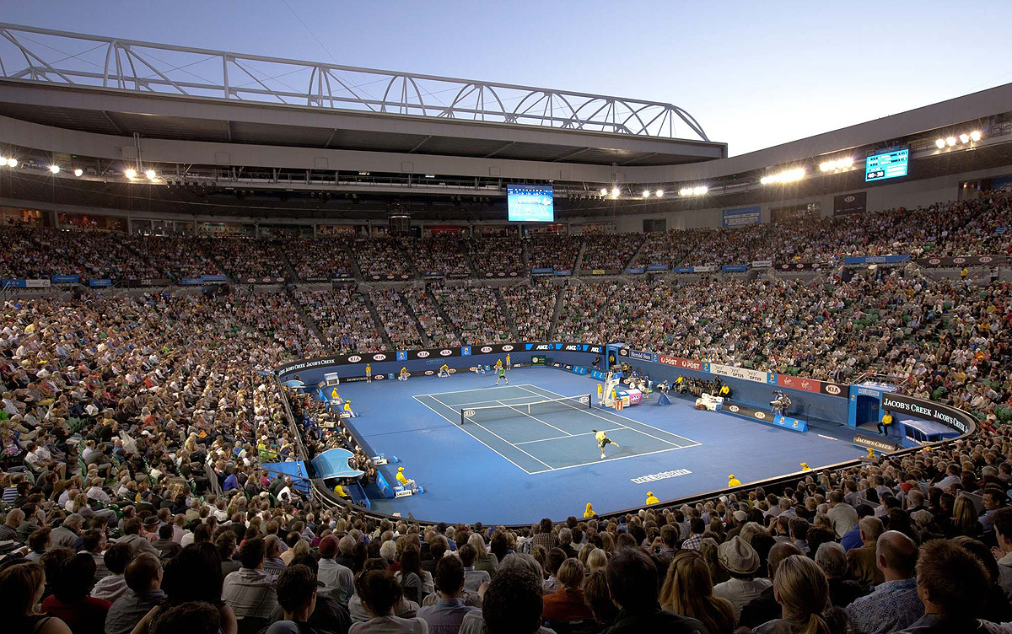
Australian Open (cont.)
Rod Laver Arena (named after 11-time Grand Slam Champion Rod Laver)
Opened in 1988
Seats 14,820 people
Retractable roof

Slide 8
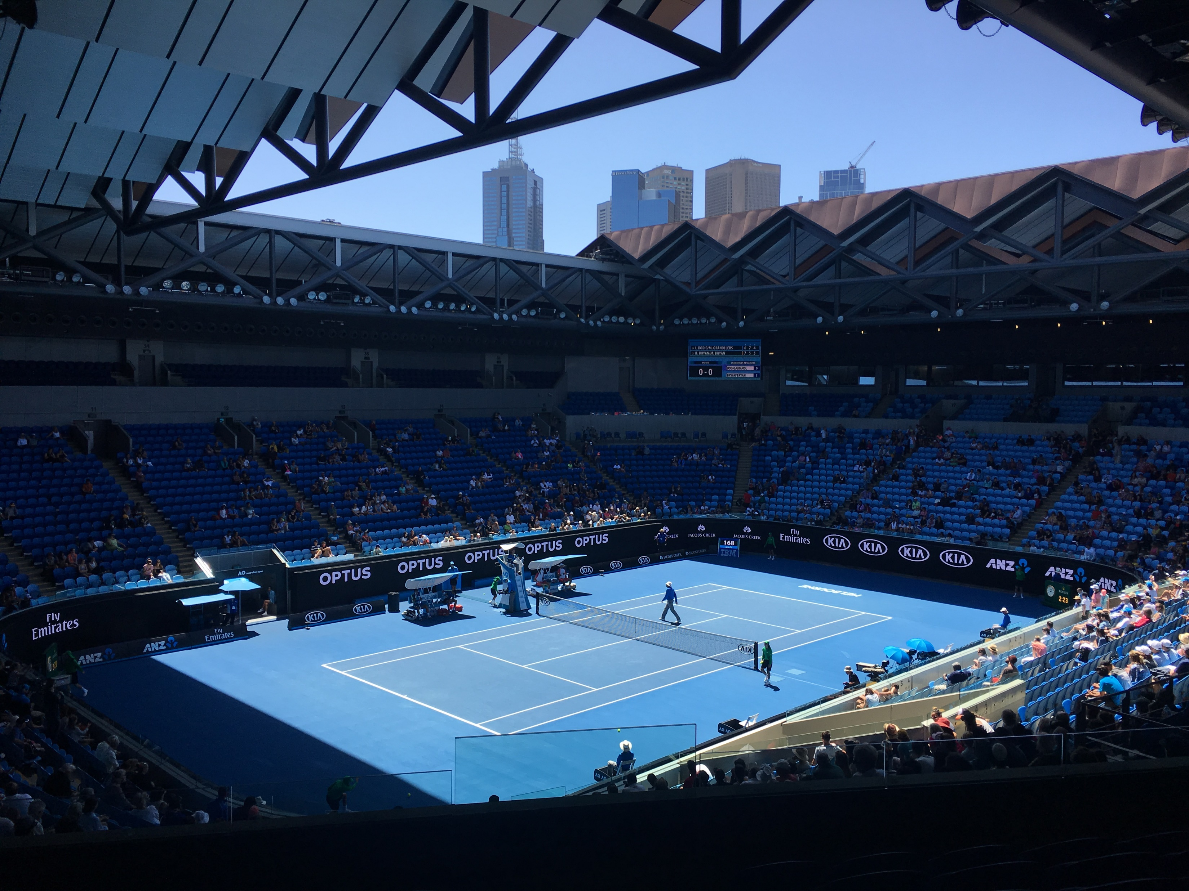
Australian Open (cont.)
Margaret Court Arena
Named after 24-time Grand Slam Champion Margaret Court
Opened in 1988
Seats 7,500 people
Retractable roof

Slide 9
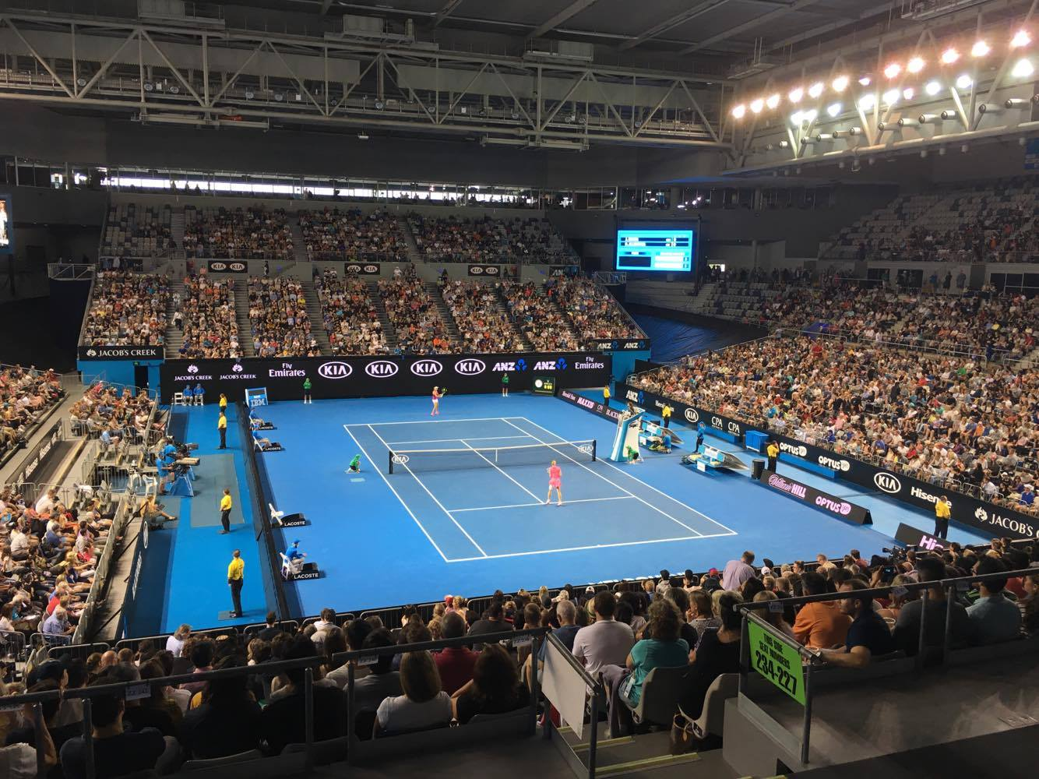
Australian Open (cont.)
Melbourne Arena
Opened in 2000
Seats 10,500 people
Retractable roof

Slide 10
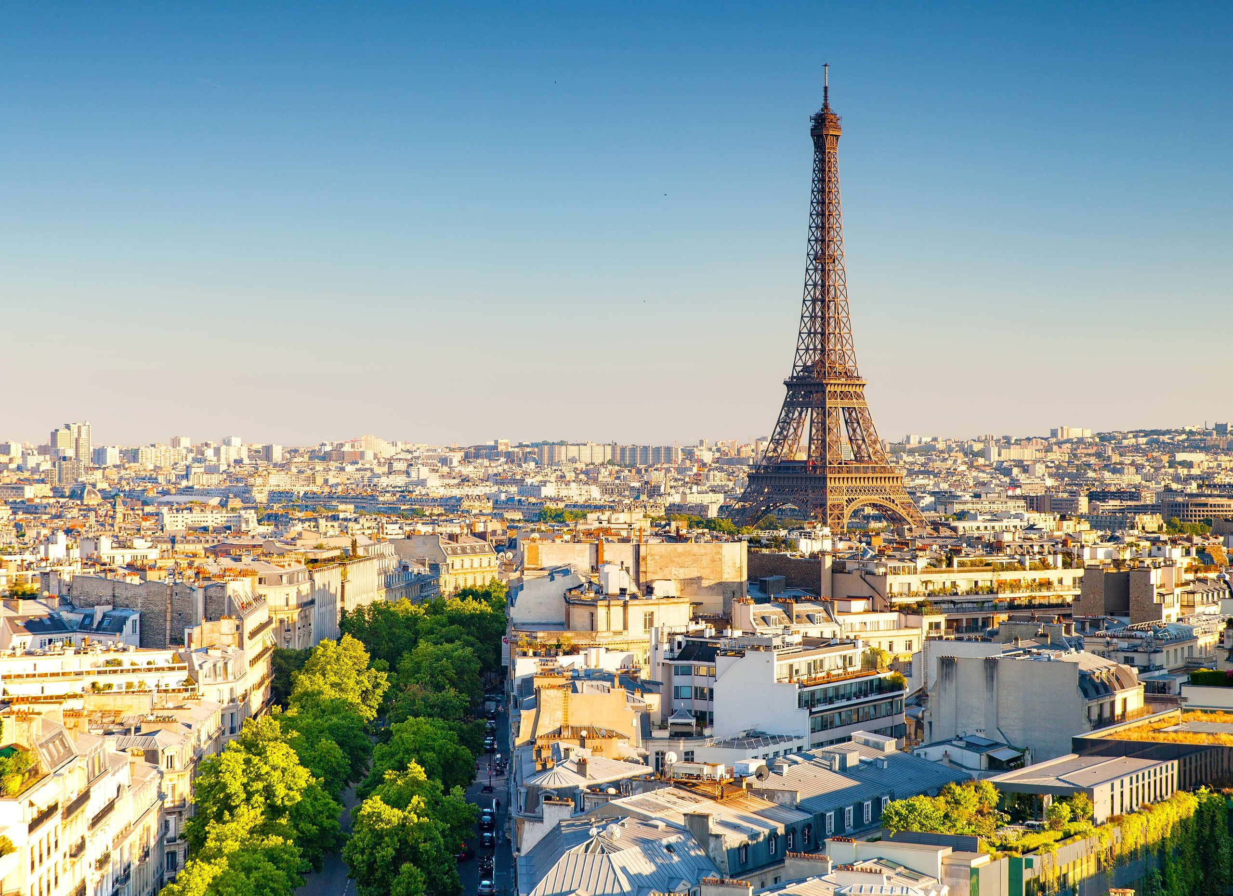
French Open
Second Grand Slam of the Year held in Paris, France
Three primary courts
Court Philippe-Chatrier
Court Suzanne-Lenglen
Court Simonne Mathieu

Slide 11
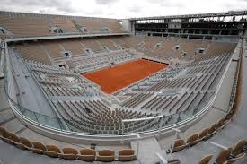
French Open (cont.)
Court Philippe Chatrier
Built in 1928
Seats 15,225 people

Slide 12
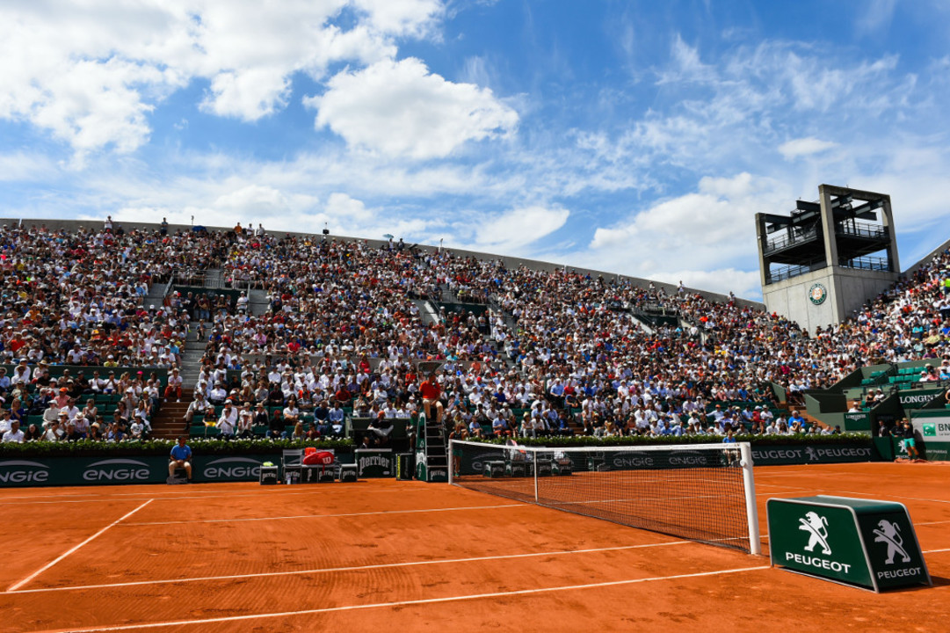
French Open (cont.)
Court Suzanne Lenglen
Built in 1994
Seats 10,068 people

Slide 13
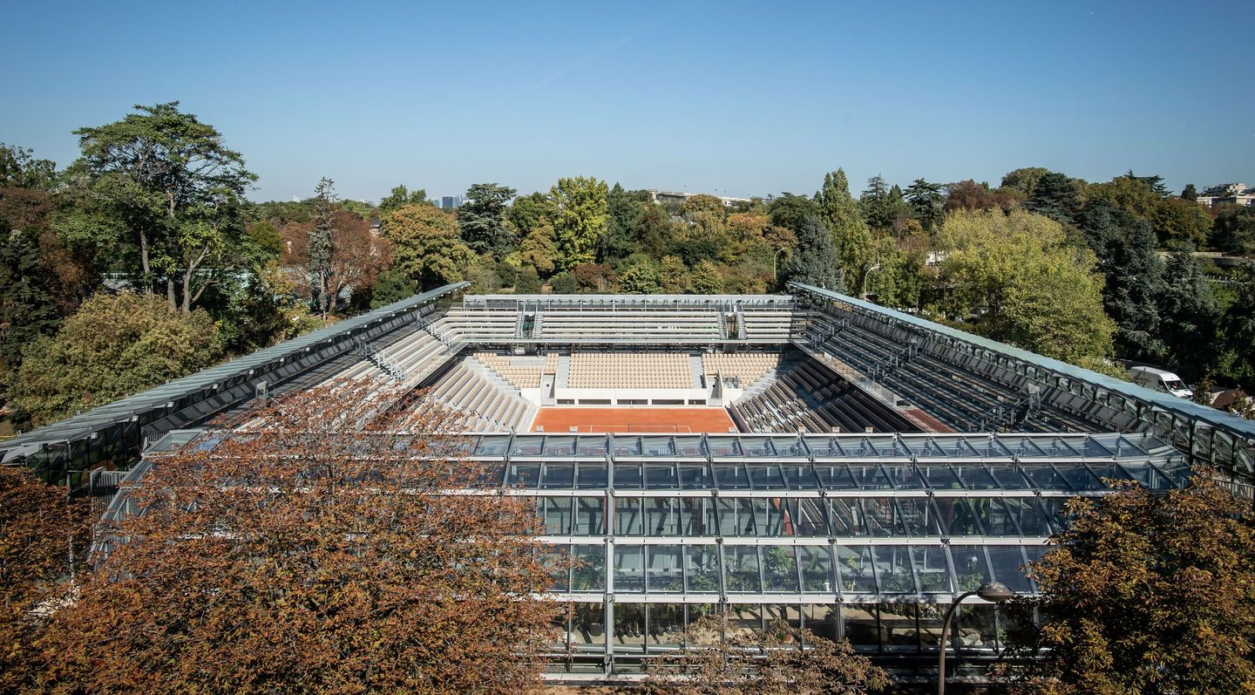
French Open (cont.)
Court Simonne Mathieu
Built in 2019
Seats 5,000 people

Slide 14
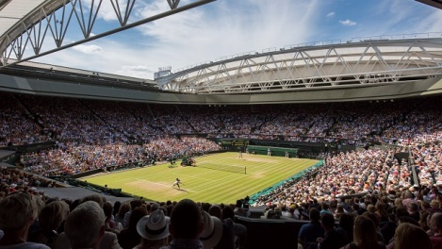
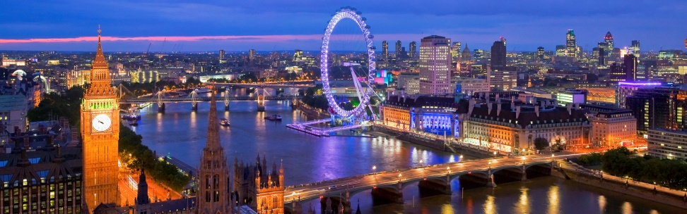
Wimbledon
Third Grand Slam of the Year held in London, UK
Main court is Center Court and has a retractable roof

Slide 15
US Open Series
Started in 2004
Tune-up summer hard court tournaments leading up to the US Open that help players to get ready for the tournament
10 different tournaments played in North America for six weeks
Women: Washington DC, San Jose, Montreal, Cincinnati
Men: Atlanta, Washington DC, Toronto, Cincinnati, Winston-Salem
Men & women sometimes alternate between Montreal & Toronto when playing in Canada
Adds lots of bonus money to the US Open
Winner: Doubles prize money at the US Open
Runner-up: Receives 50% of prize money
3rd place: Receives 25% of prize money

Slide 16
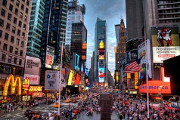
US Open
Fourth & final Grand Slam of the Year held in Flushing Meadows, NY
Two main courts
Arthur Ashe Stadium
Louis Armstrong Stadium

Slide 17
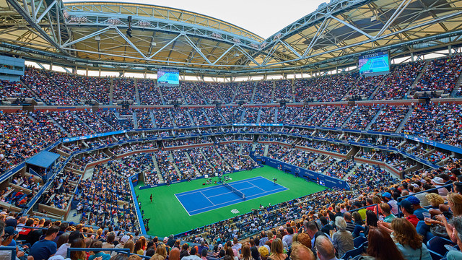
US Open (cont.)
Arthur Ashe Stadium
Opened in 1997
Seats 23,771 people
Retractable roof

Slide 18
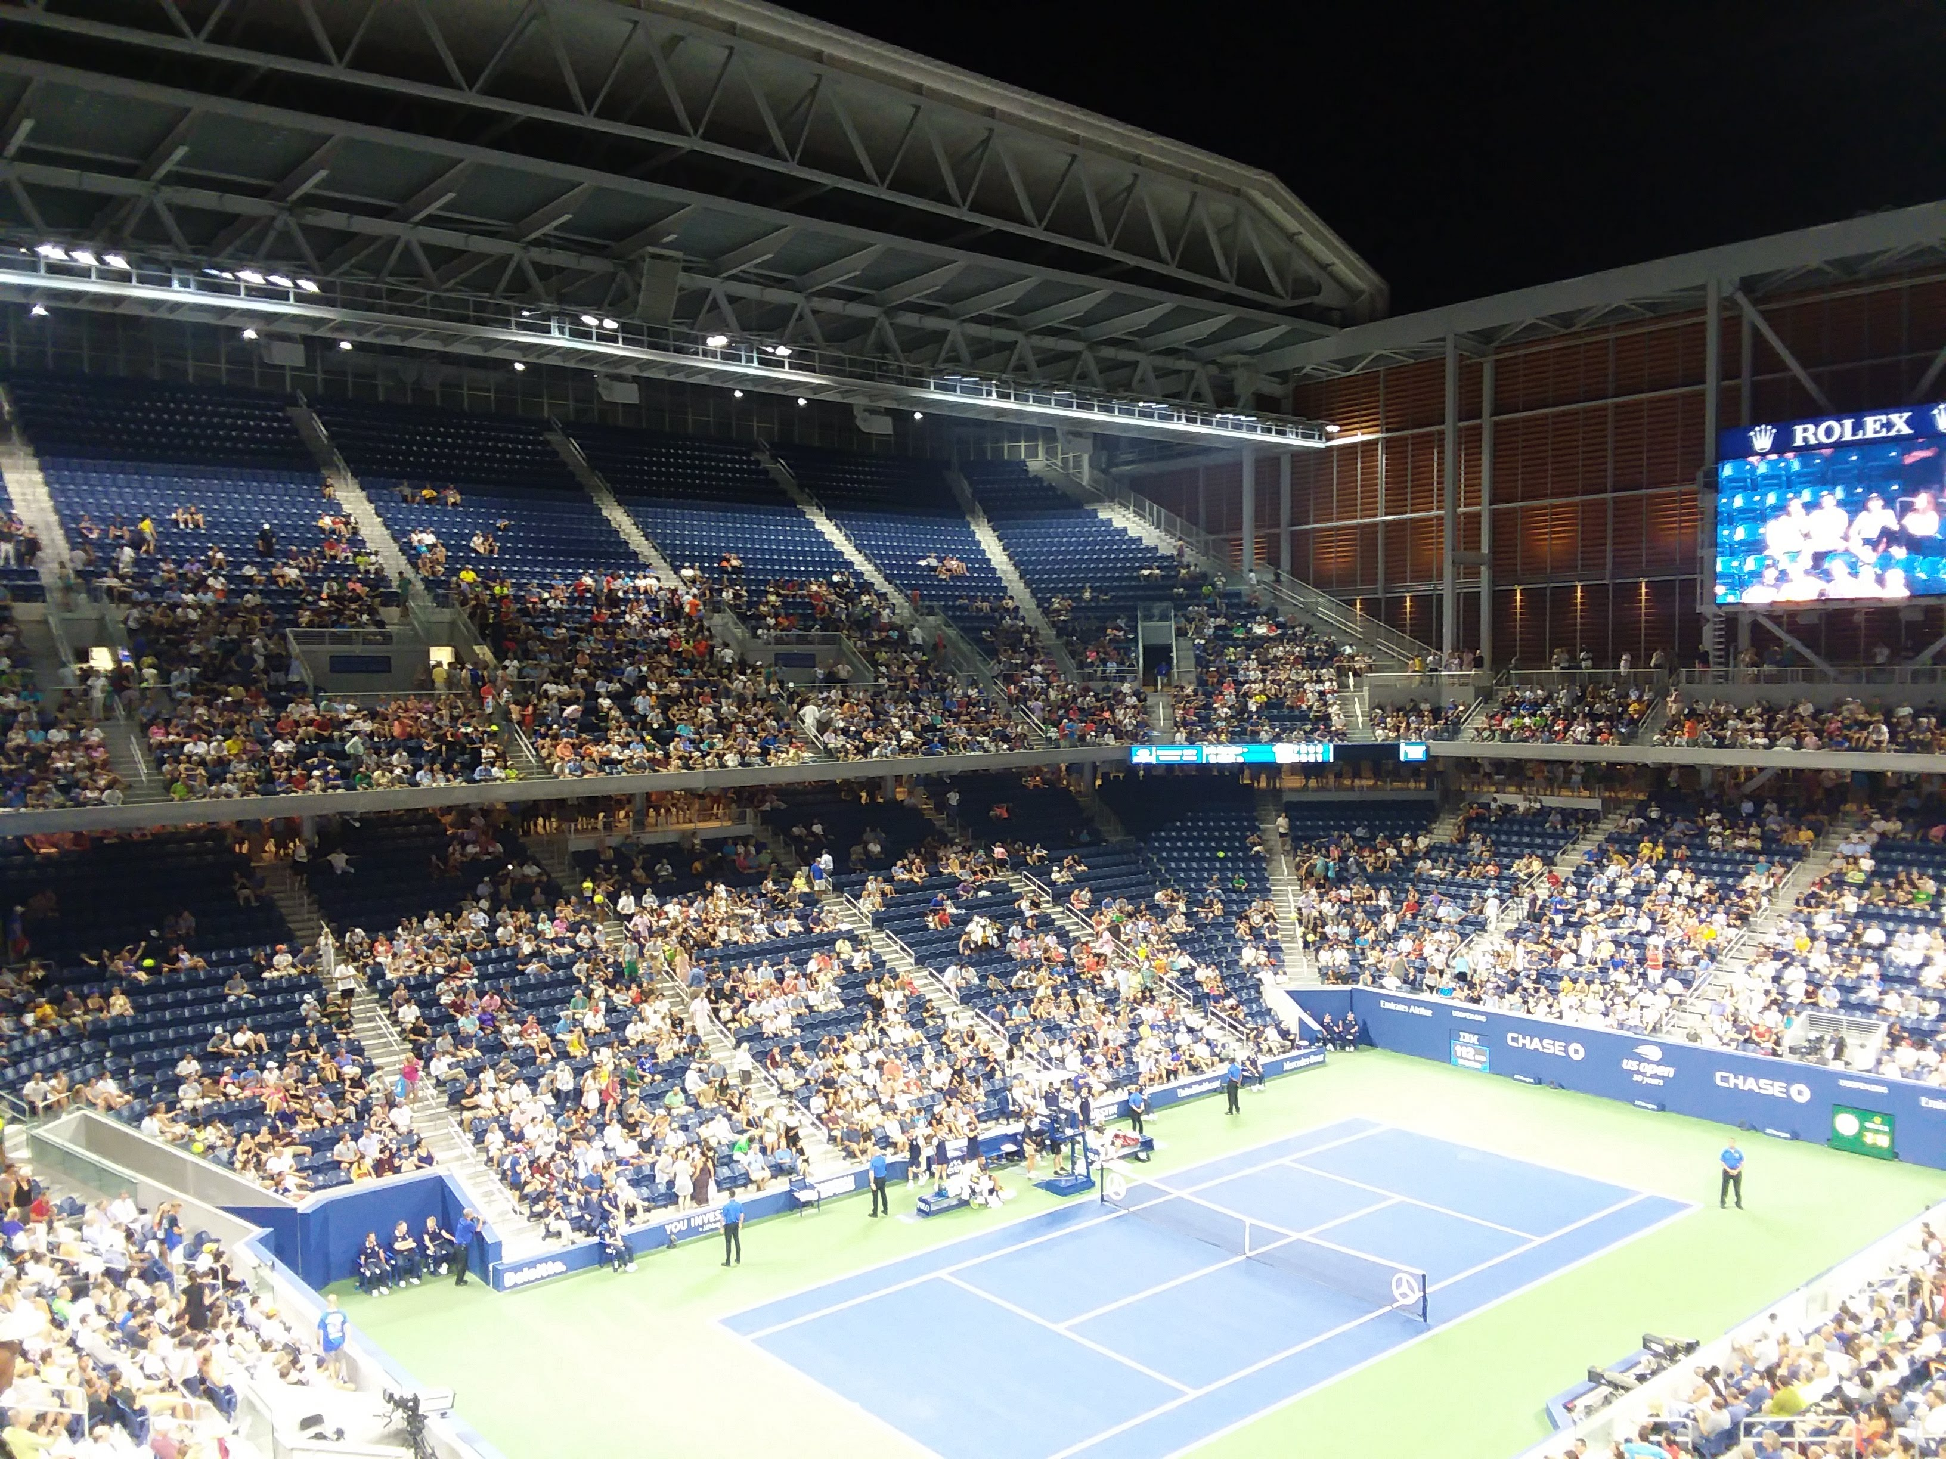
US Open (cont.)
Louis Armstrong Stadium
Opened in 1978
Seats 14,061 people
Retractable roof

Slide 19
Surfaces
Four different surfaces
Hard
Clay
Grass
Carpet
Also have indoor clay, hard, and carpet surfaces
No Grand Slams on these surfaces
Some seeded players do not need to play first round
First-round bye

Slide 20
Seeding
Seed: Rank of tennis player
Players play in tournaments at different times of the year in various locations worldwide
Win matches: Rank increases
Lose matches: Rank decreases
Need to be able to defend points accumulated from previous years, based on which tournaments player participated in

Slide 21
Draws
Draw: Order of play
Randomly computerized
Determines who plays in which round
First & second seeds are placed at opposite ends of draw
Do not want the two best players in the world meeting before the championship match
Win: Move to the next round
Lose: Out of the tournament
First week
First through fourth rounds
Second week
Quarterfinals through championship

Slide 22
Draws (cont.)
Each player gets one or two days of rest between rounds
Top half of draw plays one day
Bottom half plays the next day
Keep on alternating throughout the entire tournament

Slide 23
Schedule: Singles & Doubles
Singles: 128 players in play-offs
Seven rounds played
First, second, & third rounds
Round of 16
Quarterfinals
Semifinals
Championship
Doubles: 64 players in play-offs
Six rounds played (No Round of 16)
First, second, & third rounds
Quarterfinals, Semifinals
Championship

Slide 24
IBM SlamTracker
Scores, statistics & analyses of matches in Grand Slams
Winners
Forehand: Left-handed or right-handed
Usually the hand you write with
Backhand: One-handed or two-handed
Volley: Shots placed at the net
Ace: Unreturnable serve

Slide 25
IBM SlamTracker (cont.)
Errors
Unforced: Shots that player can avoid losing points on
Forced: Player is unable to return opponent’s point
Double Fault: Player misses both first and second serves
IBM Social Sentiment
Analysis of positive views on Twitter for a player
Serena Williams
#teamserena
#renasarmy
#serenafriday
#serenawilliams

Slide 26
23-time Grand Slam Champion
Serena Williams (USA)

Slide 27
Serena’s Profile
Born on September 26, 1981 in Saginaw, MI
Started playing tennis at the age of three after moving to Compton, CA
Was first coached by her father, Richard Williams, before being coached by Patrick Mouratoglou after training at his tennis academy in Paris in June 2012
Husband is Alexis Ohanian, co-founder of Reddit
Daughter, Alexis Olympia Ohanian Jr., was born on September 1, 2017 in Palm Beach Gardens, FL

Slide 28
Serena’s Profile (cont.)
Older sister, Venus, is also a tennis player
Won 14 of Grand Slam doubles titles together
Australian Open (2001, 2003, 2009, 2010)
French Open (1999, 2010)
Wimbledon (2000, 2002, 2008, 2009, 2012, 2016)
US Open (1999, 2009)
Both sisters have played each other in Grand Slam finals nine times (Serena has won seven of those nine meetings)
Australian Open (2003, 2017)
French Open (2002)
Wimbledon (2002, 2003, 2008, 2009)
US Open (2002)

Slide 29
Serena’s Playing Style
Powerful, consistent serve
Served 102 aces in the tournament when she won her fifth Wimbledon title in 2012
Forehand & backhand are her most powerful shots
Her power shots have precise placement, great accuracy, & high consistency
Can also play strong in both offense & defense

Slide 30
Serena’s YTD Stats
YEAR | TOURNAMENTS | TITLES | WINS | LOSSES | PERCENTAGE
1997 | 5 | 0 | 9 | 5 | 44%
1998 | 11 | 0 | 29 | 11 | 62%
1999 | 12 | 5 | 41 | 7 | 83%
2000 | 11 | 3 | 37 | 8 | 78%
2001 | 10 | 3 | 38 | 7 | 82%
2002 | 12 | 8 | 56 | 5 | 91%
2003 | 8 | 4 | 38 | 3 | 92%
2004 | 12 | 2 | 39 | 9 | 77%
2005 | 8 | 1 | 18 | 6 | 67%

Slide 31
Serena’s YTD Stats (cont.)
YEAR | TOURNAMENTS | TITLES | WINS | LOSSES | PERCENTAGE
2006 | 4 | 0 | 12 | 4 | 67%
2007 | 13 | 2 | 35 | 10 | 71%
2008 | 13 | 4 | 44 | 8 | 82%
2009 | 16 | 3 | 50 | 12 | 76%
2010 | 6 | 2 | 25 | 4 | 84%
2011 | 6 | 2 | 22 | 3 | 86%
2012 | 15 | 7 | 58 | 4 | 93%
2013 | 16 | 11 | 78 | 4 | 95%
2014 | 16 | 7 | 52 | 8 | 85%

Slide 32
Serena’s YTD Stats (cont.)
YEAR | TOURNAMENTS | TITLES | WINS | LOSSES | PERCENTAGE
2015 | 13 | 5 | 53 | 3 | 94%
2016 | 8 | 2 | 38 | 6 | 84%
2017 | 2 | 1 | 8 | 1 | 88%
2018 | 7 | 0 | 18 | 6 | 67%
2019 | 8 | 0 | 25 | 6 | 76%
2020 | 3 | 1 | 17 | 5 | 71%

Slide 33
Serena’s YTD Wins-Losses

Slide 34
Serena’s Winning Percentile Range

Slide 35
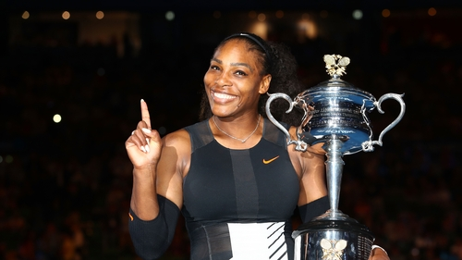
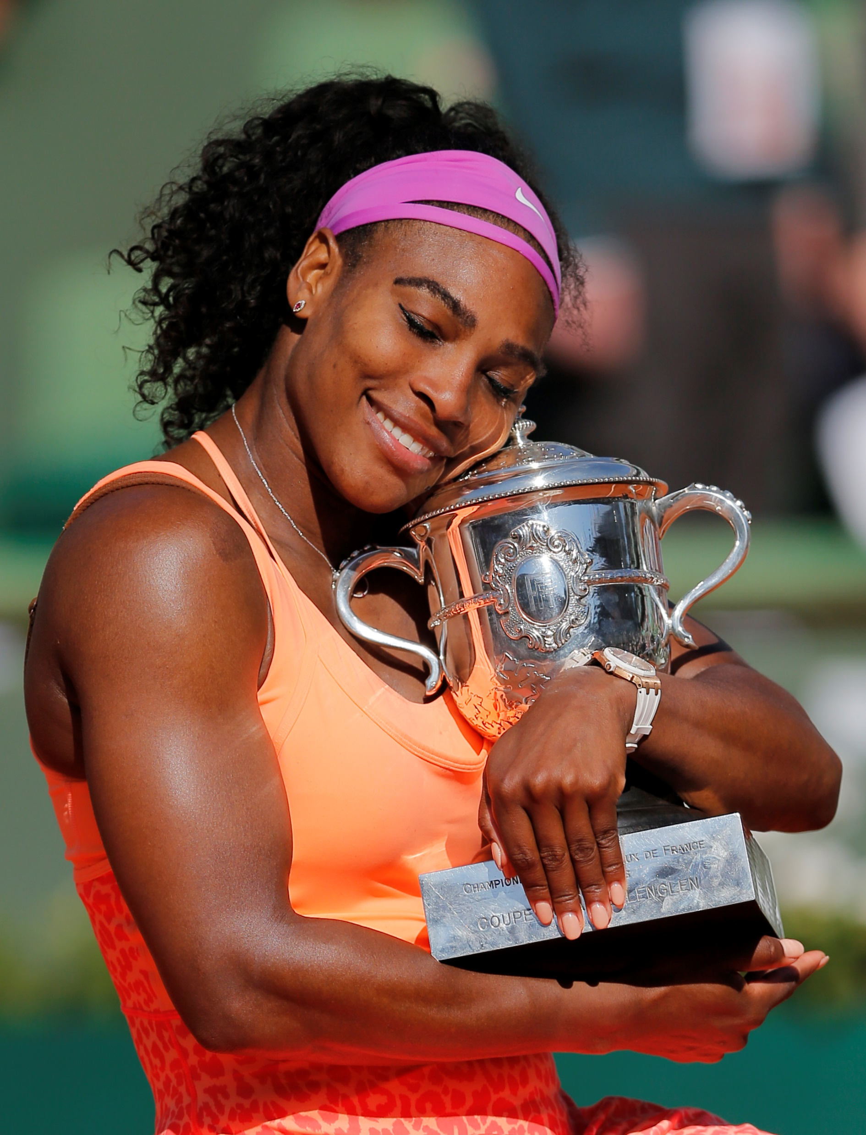
Serena’s 23 Grand Slams
Australian Open
2003
2005
2007
2009, 2010
2015
2017
French Open
2002, 2003
2015

Slide 36
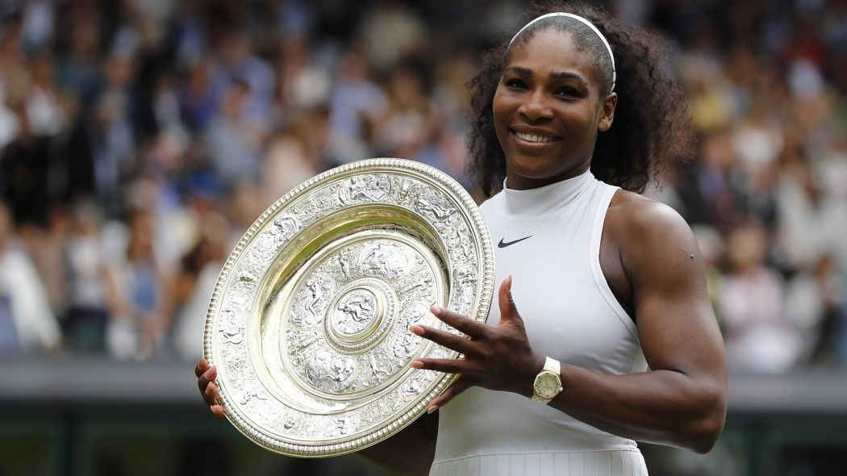
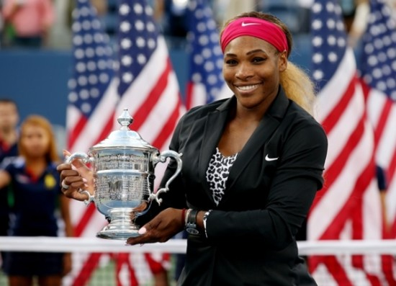
Serena’s 23 Grand Slams (cont.)
Wimbledon
2002, 2003
2009, 2010
2012
2015, 2016
US Open
1999
2002
2008
2012, 2013, 2014

Slide 37
Serena’s 23 Grand Slams (cont.)
Won ten Grand Slam titles after turning 30 years old
Australian Open: 2015, 2017
French Open: 2013, 2015
Wimbledon: 2012, 2015, 2016
US Open: 2012, 2013, 2014
Won six Grand Slam titles without dropping a set
2017 Australian Open: Won while she was two months pregnant with her daughter
Wimbledon: 2002, 2010
US Open: 2002, 2008, 2014

Slide 38
Sources
http://www.ausopen.com/index.html
http://www.rolandgarros.com/en_FR/index.html
http://www.wimbledon.com/index.html
http://www.usopen.org/
http://www.wtatennis.com/
http://www.atpworldtour.com/

